Slide 1
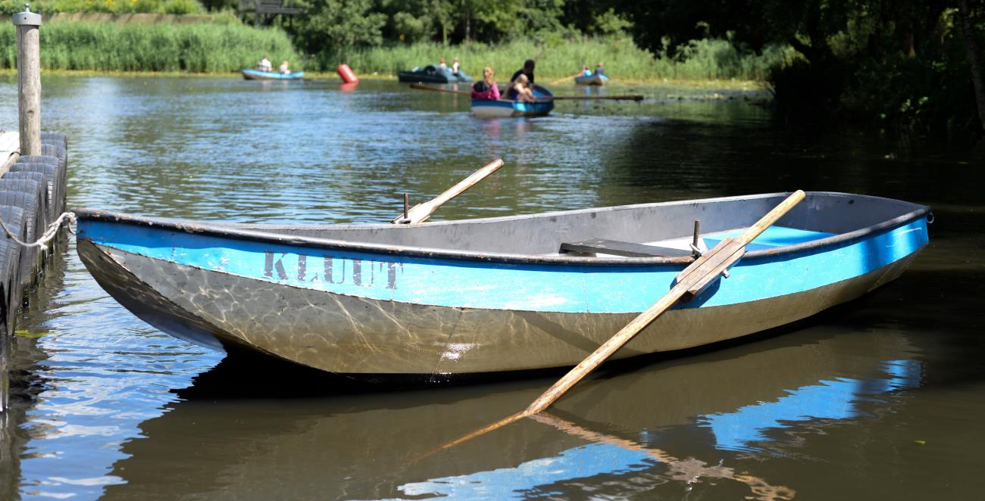
Anglican Identity and Worship
– keeping our moorings
Mark Earey
Director of Anglican Formation and tutor in Liturgy,
The Queen’s Foundation, Birmingham
Consultant member of the Liturgical Commission

Slide 2
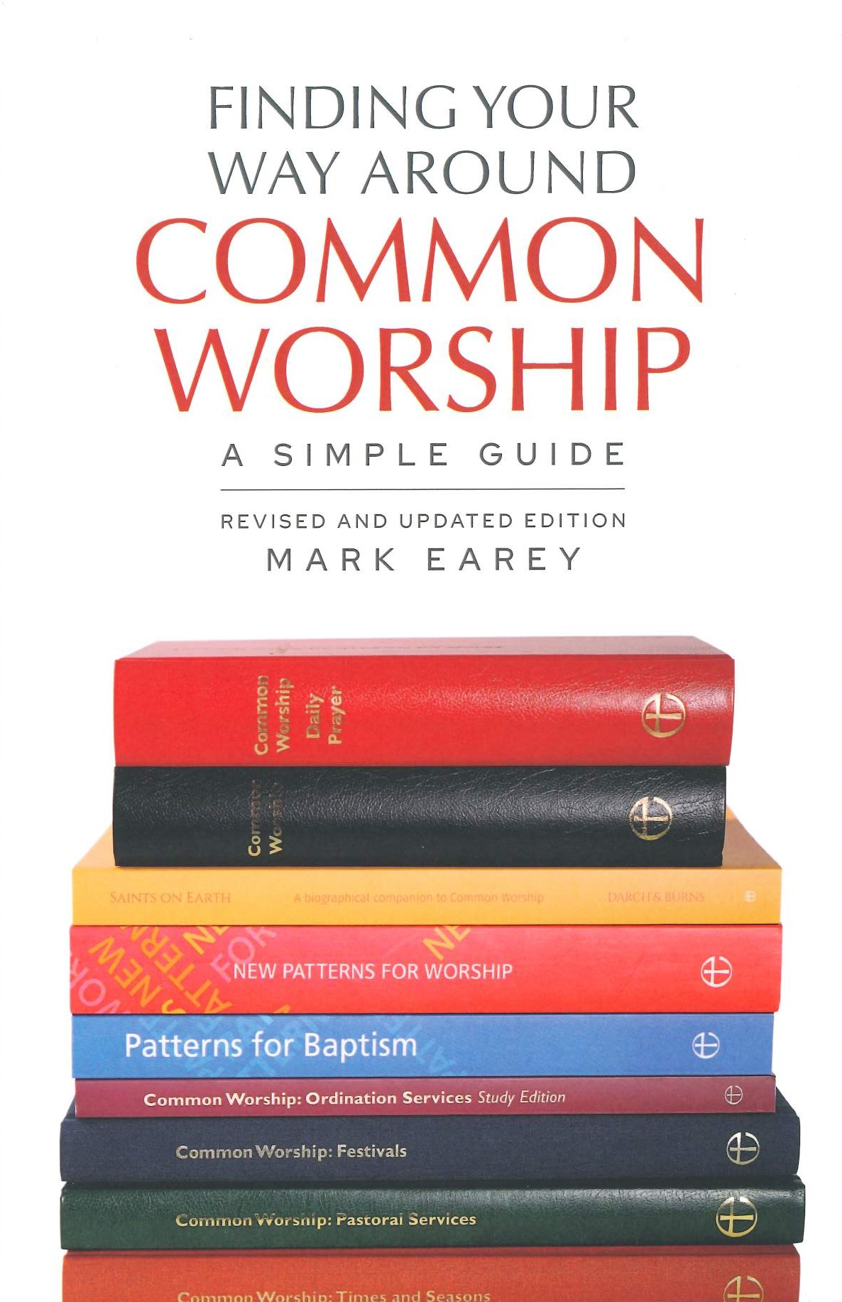
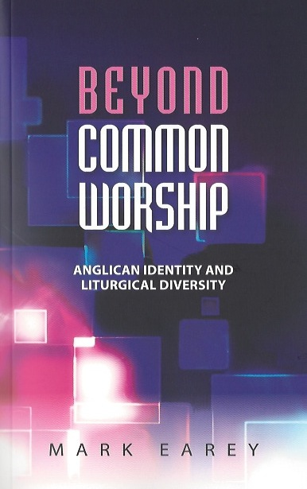
Gamekeeper and poacher…
Notes:
Two books about Common Worship. Not a cynical marketing ploy to capture the whole market – simply writing one helped me to see the need for the other.
CW - You know there’s a problem because it needs a ‘simple guide’!
I think there is a problem – no one is addressing it – ‘don’t ask don’t tell’ approach pushes creativity and missional responses underground.
I’m going to tell you what the rules are – personally I think they need to change.

Slide 3
What makes worship ‘Anglican’?
If you had to produce a list, what would be on it?
Notes:
This could be retired brigadier on the PCC who wants to know if the monthly all age service is ‘proper’, or a former Baptist, who doesn’t get the whole ‘rules’ idea at all.
What things are on your list?
Is it ‘authorized content’ or is it ‘look and feel’ – ie. Prescriptive or descriptive
Books
Vestments
Authorised liturgy
…
Key point is that 70 years ago the answer would have been obvious - the Prayer Book. In the 1970s,
This would have been true of the C of E and also the wider Anglican Communion.

Slide 4
CofE worship - distinctives
Content
‘Look & Feel’
Control
Notes:
Content – things to do with actual words or elements of a service
Are these really distinctive to C of E?
Some of them distinctive without being unique
e.g. lectionary is not unique to C of E, but it is distinctive compared to denominations that don’t use one.
e.g. Collect is a distinctively Anglican form of prayer, though also features in RC church
Look and feel – what others might expect when they walk into a C of E service
This is often descriptive rather than prescriptive.
Robes
Service books
Incense?
This is always changing – as traditions change and as rule (e.g over robes) change
Control – who decides?
e.g. a lectionary is not distinctive in the sense of unique, but the way the decision is taken about whether to use it might be

Slide 5
Where are decisions ‘held’?
Control
Central
control
e.g. Roman Catholic
Local control e.g. Baptist
CofE
Central
Local
Local
Local
Local
Central
Local
Local
Local
Local
Notes:
C of E sits somewhere between congregational control and universal control.
Has moved more towards congregational control in recent years.
NB – ‘local control’ can just mean local leaders.
One of Cranmer’s aims was to distribute power between centre and congregations, removing power of local leaders, through visible stable structures and understandable words.

Slide 6
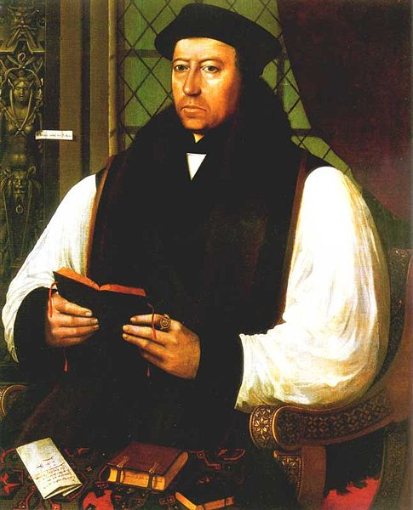
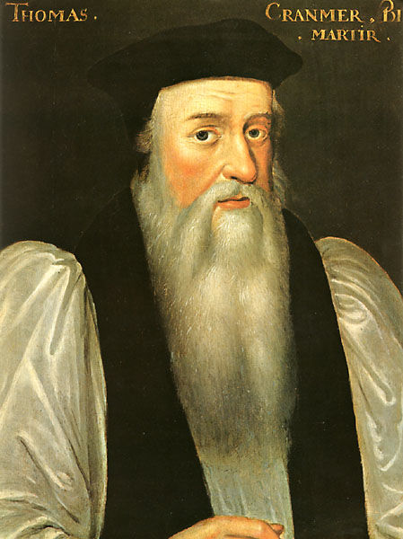
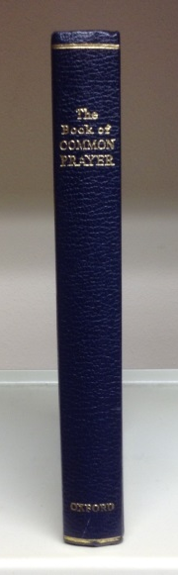
Anglican principles 1
Lex orandi: lex credendi
Doctrine and worship are linked
Law of prayer: law of belief
Contested origins
The ‘text’ matters
Notes:
Lex orandi: Lex credendi
Anglicans tell themselves that this is ‘our’ thing. It’s partly true.
Our doctrine is connected to our liturgical text as well as Bible and creeds.
Because our origins are contested (beard or no beard – the two very different Cranmers, Evangelical or Catholic), doctrine is always an issue.
Because doctrine is an issue, the text of the book is fought over.
F Exp (and other creatives) formed in a different era, don’t see the issues
let’s see worship as a place to explore belief
Traditional Cof E – lets’ see worship as a place to protect or defend belief.

Slide 7

Anglican principles 2
The Catholic-local tension
The CofE is not congregational
Not all decisions about worship are taken at local level
Catholic
Local
Connection
Context
Accountability
Trust
Notes:
C of E is not congregational in ecclesiology.
Not all decisions about worship are therefore yours to take a congregational level (if you can’t live with that you are in the wrong denomination).
This is about being accountable beyond the congregation
CofE lives with constant tension between local and wider church, or context vs. connection. How to we ‘belong’ and connect beyond ourselves?
Where does the centre of gravity fall?
(whether you think it’s in the wrong place depends on what you compare it to: Rome or local baptist church)

Slide 8

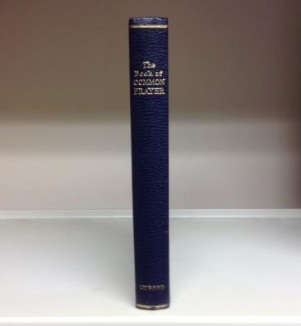
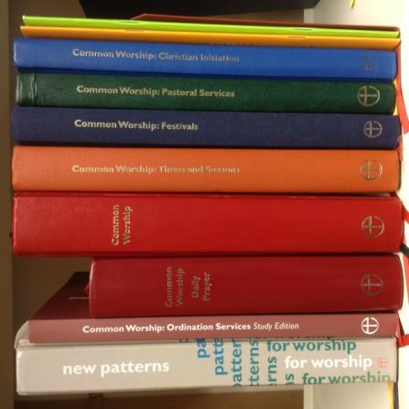
The CofE and liturgical identity
What is
Anglican identity
and
liturgical
when you have
diversity
?
identity
Notes:
Anglican identity has historically been liturgically focused – in the Book of Common Prayer.
So, what happens to your identity when you have liturgical diversity?
KEY POINT – This has led to a lot of anxiety in the C of E – especially in 1980s.
Formation of Prayer Book Society not just about preserving form and language, but commonality.

Slide 9


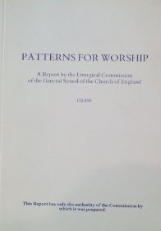
Anglican ‘content’?
‘Some of the marks which should be safeguarded for those who wish to stand in any recognizable continuity with historic Anglican tradition are:’
Recognizable structure
Emphasis on reading scripture and using psalms
‘Liturgical’ words, repeated, known
Using a collect, Lord’s Prayer, some responsive forms
Centrality of Eucharist
Concern for form, dignity, economy of words
Liturgical Commission, Patterns for Worship report, 1989
Notes:
A previous generation wrestling with the same issues – re. Urban contexts, all age worship etc.
Patterns for Worship report, 1989 – the invention of the Service of the Word structure – an attempt at flexibility.
‘Some of the marks which should be safeguarded for those who wish to stand in any recognizable continuity with historic Anglican tradition are:’
- This is a very defensive statement and approach.

Slide 10
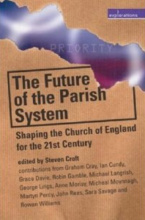
An ‘Anglican’ way forward?
Texts
?
Shape
Notes:
Steve Croft, The Future of the Parish System.
At the end he has a section on the future of Anglican identity generally – because even this is contested!
TEXTS – i.e BCP, Articles of Religion – the old way of defining Anglican.
SHAPES – i.e. structures, such as parish system, having a PCC etc. (and in worship a parallel move)
‘Shapes’ is breaking down (particularly under pressure from Fresh Expressions).
Thinks next step is to define the unity of the Communion in terms of common VALUES.
Croft proposes
Chicago-Lambeth Quadrilateral
Five Marks of Mission
[These apply to worship as well as general identity.]

Slide 11
‘Common prayer’ today?
- the intention behind CW
Shape
‘Family likeness’
Recognisable structure/s
Texts
‘Evolving core’
Notes:
This was how the sense of Anglican ‘commonality’ was meant to work in CW.
Fear of loss of any commonality due to such variety.
Need to find some sort of ‘common’ - but not the content-based commonality of BCP
‘Family likeness’ as one way of naming this – not easily pinned down.
Common Worship named as such, deliberately to echo Book of Common Prayer.
KEY POINT – this has worked for the 70% of the C of E that is in the middle of the ‘normal’ curve of the C of E.
But where it hasn’t worked, it ‘hasn’t worked’ quite spectacularly!

Slide 12
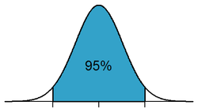
Is CW working?
‘Yes’
to a greater or lesser degree
70%?
‘No’
for a range of reasons
Notes:
Normal distribution curve.
Could be Yes and No in the same church – e.g. Sunday Eucharist is fine: Messy Church not so much.
We’re going to start with the 70% in the middle…

Slide 13

The Declaration of Assent: expressing accountability and trust (in a particular way)
‘…in public prayer and administration of the sacraments, I will use only the forms of service which are authorized or allowed
by Canon.’
Common Worship main volume, p.xi
Notes:
This is what this is all about – holding the two together – that decisions about worship are not taken entirely at congregational level – i.e. it’s a value to do with our ecclesiology, which is not congregational.
Authority and accountability are held at a trans-local level.
Note 2 key things:
It’s public prayer and sacramental worship that becomes controlled by this: if it’s private, low-key and non-sacramental, it doesn’t apply
The bind here is that it’s only as a F Exp grows and wants to become more ‘church-like’ that it hits
It’s authorized and allowed – the two are not the same.

Slide 14
What is authorized?
Authorized
BCP
1662
Authorized alternatives
- e.g. Common Worship
Notes:
Authorized is anchored in the BCP – this is our starting point.
The other part of the ‘authorized’ category – services which have been through a process of authorization, alongside BCP, by General Synod.
NB – ‘authorized’ does NOT mean:
The bishop has said I can do this; or
The Anglican church of [e.g. Kenya] has authorized this.
It has to be authorized by CofE General Synod.

Slide 15
Authorized and allowed
Authorized
Allowed
BCP
1662
Authorized alternatives
Notes:
What does authorized and allowed look like?
Allowed is much bigger than authorized – but it isn’t boundless.
But it gives shape to the tension between the central control and local decisions which is at the heart of Anglican ecclesiology

Slide 16

A spectrum of response
Only what’s authorized or allowed
What’s the least I can get away with?
Unless it’s like this, it isn’t Anglican.
‘Go with
the grain’
Dalai Lama: 'Learn the rules so well that you know how to break them.'
Notes:
Two common mentalities:
‘What’s the least I can get away with’
‘You must do it this way or it isn’t Anglican’
Neither is helpful.
Better to work with ‘The Spirit of the law’ - go with the grain. Intention is to honour the rules, so break them with a heavy heart, rather than ‘Who cares about the rules’.
This is different from ‘I know better than the rules’ and ignoring them.
KEY POINTS FOR ACTION:
Understand what the rule is there to protect – and work with that.
Break the rules only for particular contexts, a limited time and good reasons
If you think the rules need to change – work to change them.
Pablo Picasso said ‘Learn the rules like a pro so you can break them like an artist’ although that attribution might not survive a fact check – similar attributed to Dalai Lama.

Slide 17

Pushing the Boat Out – shaping worship in new settings

Slide 18
Rules for a new context
What changes or concessions to the normal liturgical rules would you expect for a ‘Fresh Expression/pioneer/NWC’ situation?
Notes:
E.g. – messy church, forest church, or café church
Answer – none.
Even Bishops’ Mission Orders do not have provision for different liturgical rules.

Slide 19
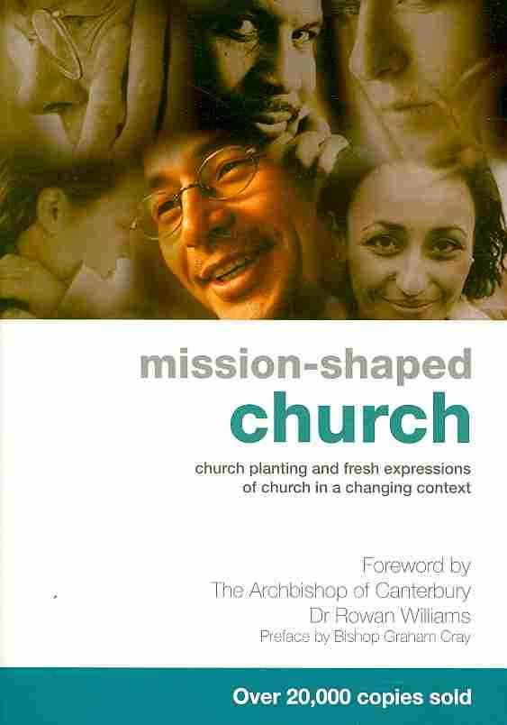

A chronological accident…
?
1997
2004
Notes:
Common Worship and Mission-Shaped Church
We are only facing this struggle and this question because of a chronological accident – important to remember, it’s not that Mission-shaped Church was already out there and then along came the liturgists with their CW ignoring it or squashing it.
If the latter had come before CW, the result might have been different.

Slide 20
An ‘Anglican Values’ way forward?
Texts
?
Shape
Values
What would they be?
Notes:
What to do when texts and shape don’t work…
Croft’s thinking about what makes a church ‘Anglican’ may well get applied to worship.
Not TEXTS (BCP, CW, etc.)
Not SHAPE – Dix, the shape and structure of services (now seen as more complicated historically)
but VALUES – e.g. ‘worship accessible for everyone’
My suggestion - key value is to be contextual (indigenous and catholic) - Rowan Williams in Identity of Anglican Worship
This would be about processes as much as content.

Slide 21
Stretching ‘Anglican’ values to the next level
BCP
CW
Connected
Contextualised
Context- driven
Accountability
Trust
over content
Accountability over process
Notes:
Taking the principle of Local and Catholic – but moving the centre of gravity more to the local and more towards trust.
BCP – majors on being connected – content shared across whole church.
CW (and before) – starts to allow for this to be contextualised – still assumes a norm that you adapt (inculturation rather than enculturation)
What about new situations – NWCs, FExp, Messy Church etc. – let alone Parish Church doing things differently – situations CW doesn’t seem to fit.
Post-CW – not just adapting a norm, but context-driven approach – start with context and then improvise with the tradition in mind.
Trust with accountability is the basic model I suggest as alternative.
You need trust, because otherwise you de-skill people and they don’t take responsibility for their own actions and choices
You need accountability, because we are not a congregational denomination – we have responsibilities to the wider church, geographically and chronologically.
Can we stretch trust, so that accountability comes not from content but from process.
C of E liturgy rules assume that the way to get good worship is by applying the right rules.
More important thing is to get good worship by nurturing good worship leaders, who are not afraid to make mistakes but who are also forced to take responsibility for their actions through a process of accountability.

Slide 22

Changing the game
Bounded set
Centred set
‘Okay’
Notes:
In a centred set, what is ‘okay’ is not a boundary, but a benchmark at the centre. What is at the core is clear - but boundaries are not policed.

Slide 23
Bounded set
Centred set
Liturgical
Text
Hymns & Songs
BCP
CW
Other ‘allowed’
A&M?
NEH?
Bible, creeds, BCP
Notes:
In worship terms the Church of England has operated both approaches.
Turn to hymnody and song and you can sing any old heresy you like… or can you?
For hymnody, there has been a centred approach - no fixed hymnbook, but a certain ‘range’ which pointed towards the Anglican-ness of what was being done.
In more recent years, different repertoire has appeared, but that doesn’t mean that anything is acceptable for Anglicans to sing.
KEY POINT - C of E deals with songs on trust.

Slide 24
For now, however…
Authorized
BCP
1662
Authorized alternatives
- e.g. Common Worship

Slide 25
Some freedoms
Canon B 5.1
Canon B 5.2
Minister may use variations which are ‘of no substantial importance’
When there’s no authorized form, minister may use anything ‘reverent & seemly’ & not contrary to C of E doctrine ‘in any essential matter’
…even in ‘authorized’ material
This gives another whole category of ‘allowed’
Notes:
B5.1
Useful for changes to presidential text (e.g. inclusive language)
No substantial importance means you are not attempting to change the doctrine being expressed (e.g. change ‘saints’ to ‘God’s people’ in Eucharistic Prayer; cf. change to ‘that this sacrifice may be offered to God…’)
e.g. ‘Jesus claims you for his own’, instead of ‘Christ’ in baptism of 2 yr old
B5.2 See guidance in NPW p. 52 about what this might mean (including, take account of where Synod has carefully not changed BCP doctrinal emphasis).

Slide 26
Authorized and allowed
Authorized
Allowed
BCP
1662
Authorized alternatives
Commended material
Unofficial material
(for which there’s no authorized form, and which is ‘reverent, seemly, & not contrary to CofE doctrine)
e.g. Communion
e.g. Good Fri
Common Worship includes…
e.g. Some parts of Iona material
Common Worship allows…
Notes:
ALLOWED
Commended – explain using ‘Communion’ and ‘Good Friday’
Unofficial material – e.g. Iona intercessions
Common Worship…
Includes wide range – from some BCP content through to ‘commended’ (mainly seasonal) material – so not everything in CW has to be used.
Allows an even wider range, because some of the authorized forms themselves allow for other material – the so-called ‘directory’ approach.
See FYWACW – p. 14 chart

Slide 27
Key questions…
More restrictive…
Less restrictive…
Sunday
Weekday
Principal Service
Additional service
Eucharist
Word
Notes:
Is it a Sunday (or major feast day)?
Is it the Principal service?
Don’t see this as tightly controlled with a set of answers – see it as part of ‘going with the grain’ – take more care over left-hand end stuff.

Slide 28
The Service of the Word umbrella
‘All Age’ services
Daily Prayer
Informal services
Youth services
Morning or Evening Prayer on Sundays
First part
of a Eucharist
Notes:
Service of the Word was a key step in shifting this from texts to structures (and maybe values: local decision-making, mission context, but connected in some way to other churches.)
Service of Word approach has influenced the whole of CW – directory approach
Umbrella for a range of situations:
All Age services – why do so many all age service planning teams not seem to have heard of it?
Youth Services – not an obvious starting point but why not? Good conversation to have with youth group to talk about belonging to more than a local congregation
MP and EP on Sunday
Daily Prayer – hence CW: DP is just a commended outworking of ASofW. Hence canonical requirement for clergy to say the office is fulfilled by this.
Informal services
First part of a Eucharist – ASotW with Holy Communion – the simplest form for Communion.

Slide 29
A Service of the Word
BEGINNING
PENITENCE*
CANTICLE & RESPONSES
…at the Principal Service on Sunday
COLLECT
BIBLE READING/S
PSALM or PSALM SONG
Doesn’t have to be in this order
SERMON
* = authorized text only
CREED/AFFIRMATION*
INTERCESSION & THANKS
Can be found:
CW main vol. pp. 21-27;
New Patterns pp. 9-14
see FYWACW Chap 3
LORD’S PRAYER
DISMISSAL
Notes:
See how this connects with the list from the report Patterns for Worship
Note only two items where authorized text is required.
NB even this structure (block structure) is not the only option - see NPW ‘conversation structure’.
Service of the Word was a key step in shifting this from texts to structures (and maybe values: local decision-making, mission context, but connected in some way to other churches.)
Service of Word approach has influenced the whole of CW – directory approach

Slide 30
A Service of the Word
BEGINNING
PENITENCE*
CANTICLE & RESPONSES
…if it is not the ‘principal service’
COLLECT
BIBLE READING/S
PSALM or PSALM SONG
SERMON
CREED / AFFIRMATION*
INTERCESSION & THANKS
LORD’S PRAYER
DISMISSAL

Slide 31
CW – 3 shapes for Communion
1
Order One (‘Classic’ shape)
Order One (Traditional)
2
Order Two (BCP shape)
Order Two (Contemporary)
3
A Service of the Word with Holy Communion
Most flexible option
Notes:
Be aware of the different shapes and their dynamic.
Make sure you are following the right service!! (and using right supplementary texts).
A Service of the Word with Holy Communion – CW main volume p. 25 – note same structure as Order One (but with clearer headings)
Note ASotW structure on p. 24 – this is the controlling structure.
Note only three bits require authorized text: Confession; Collect (!); Eucharistic Prayer.
Not to be used as regular Sunday service
Also found in New Patterns for Worship.

Slide 32
Some ‘rules of thumb’…
Restriction
Flex
Look…
Eucharistic Prayers
Some freedom to compose ‘Proper Prefaces’
NPW
‘G’
Confessions & Absolutions
Kyrie confessions (‘should not be the norm on Sundays’)
NPW
‘B’
Creeds &
Affirm’s of Faith
NPW
‘E’
[Metrical version included]
Bible readings
NPW
‘C’
Open and closed seasons
Notes:
In practice – this looks like this.
Note that these are key doctrinal areas.
Kyries – ‘should not be the norm on Sundays’ – notes to HC, p. 331, note 10

Slide 33
Opening Dialogue
Creativity and Eucharistic Prayers
Extended Preface
Local,
extempore,
borrowed,
responsive...
Sanctus (‘Holy, holy…’)
Eucharistic Prayers A, B & E
Last Supper
Anamnesis
Epiclesis
Doxology
NPW
‘G’
Notes:
Replace an extended preface with something else.
Guidance on how to do it in New Patterns.

Slide 34
Creativity and Confessions
‘Penitential sentences’
Lord, have mercy...
‘Penitential sentences’
Christ, have mercy...
‘Penitential sentences’
NPW
‘B’
Lord, have mercy...
Notes:
‘Penitential sentences’ is a broad category, and you can ‘go with the grain’ by exploring other ways of expressing penitence (i.e. actions, pictures, symbols etc.).
Using the kyrie response connects us back to early Christians and a wider Christian tradition.

Slide 35
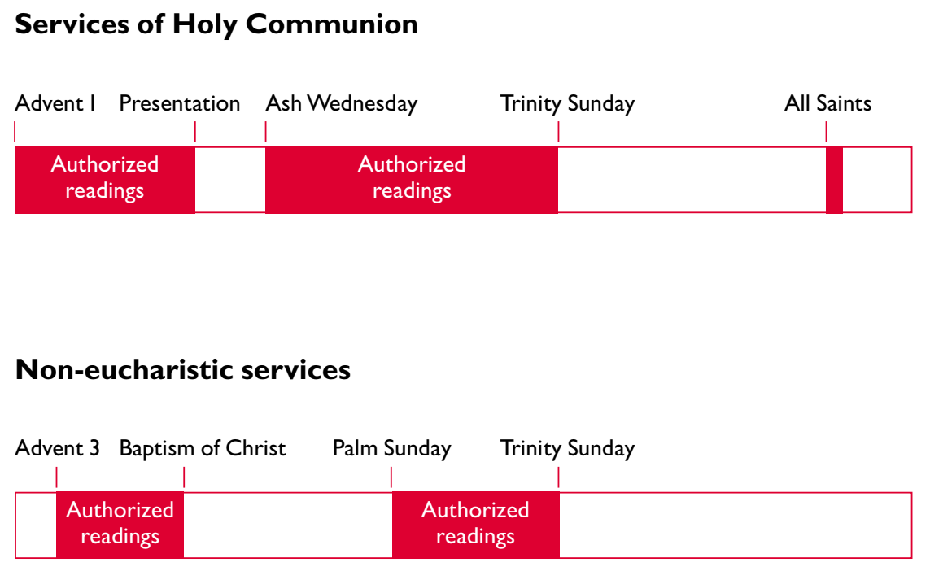
‘Closed’ lectionary season
from New Patterns for Worship p.104
Notes:
Open and closed lectionary seasons are a new idea in CW. (another way that CW ‘allows’ more than it includes)
Like grouse shooting!

Slide 36
‘Closed’ lectionary season
‘Go with
the grain’
from New Patterns for Worship p.104
Notes:
This is a good example of ‘going with the grain’
understand what the rule is trying to protect or achieve and then make sure your practice goes with the intention behind that, even if the letter of the law gets broken.
In this case, the rule is for two reasons:
balance local choice of scripture (connecting with context) with submitting to the wisdom of the wider church and the breadth of the canon (taking catholicity seriously).
Protect congregation from Vicar’s preferences and

