Slide 1
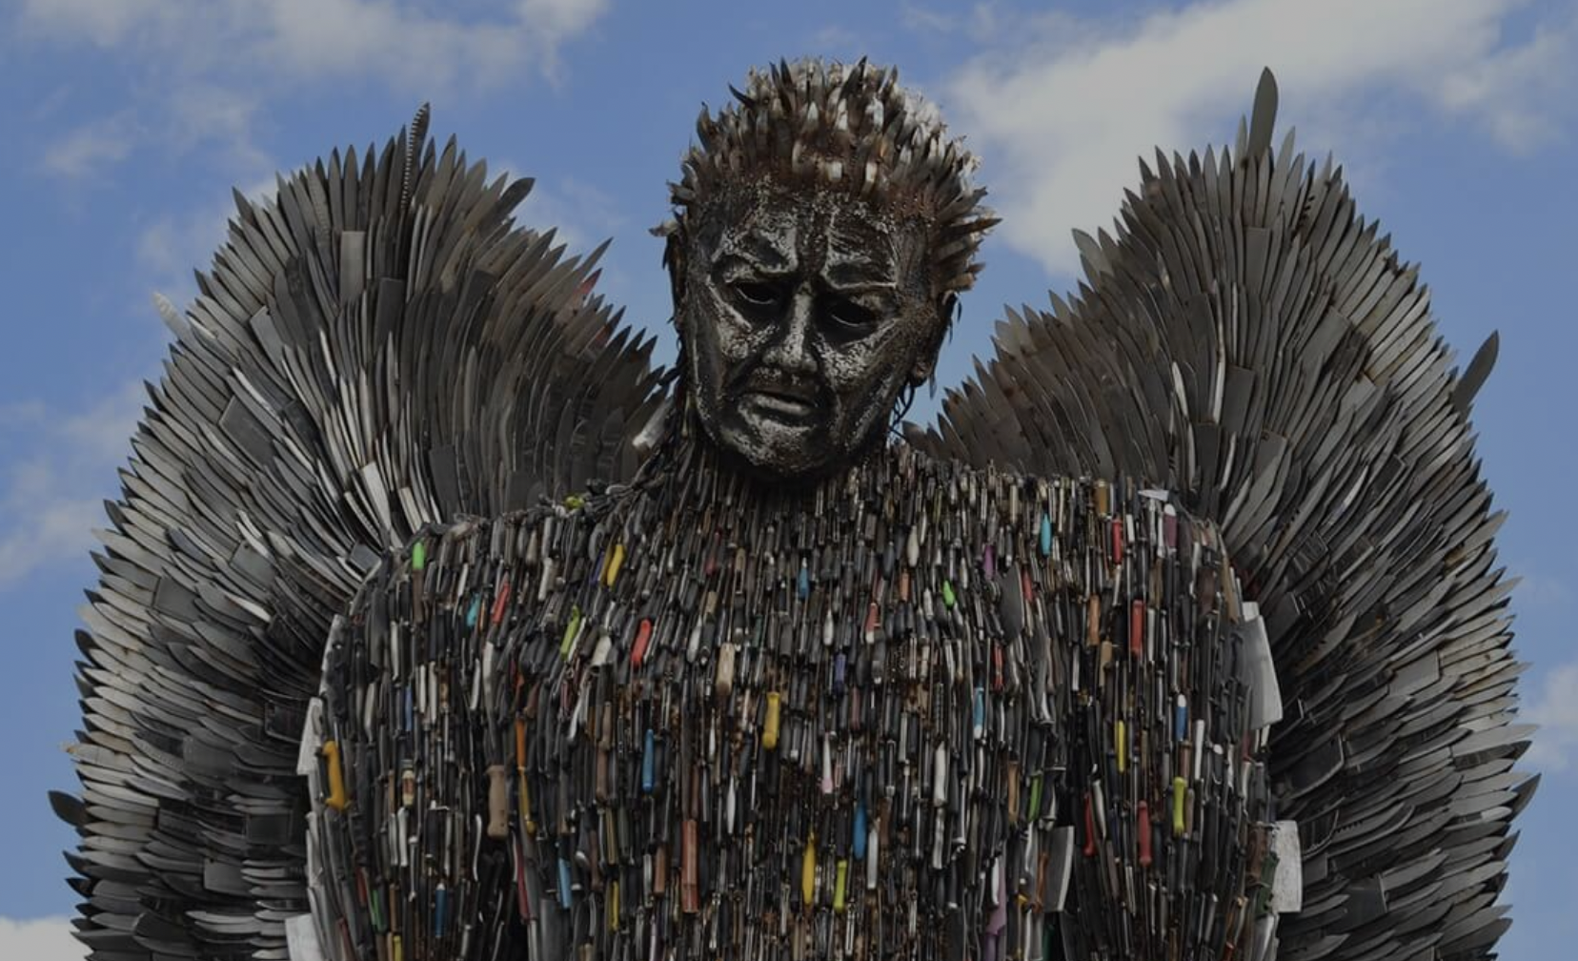
Knife Angel Quiz

Slide 2
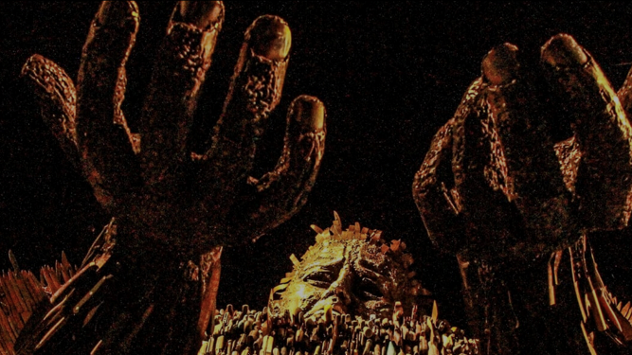
1. How many knives are used to create the Knife Angel?
100,000

Slide 3

2. How many years did it take
to create?
4 years

Slide 4

3. When did the Knife Angel begin its tour?
December 2019

Slide 5

4. How tall is the Knife Angel?
27ft (8.2m)

Slide 6
5. Where was the Knife Angel created?
Oswestry, Shropshire

Slide 7
6. Can you name another city the Knife Angel has been to on its tour?
Birmingham, Coventry, Liverpool, Middlesbrough, Rochester, Derby, Chester, Gateshead, Telford, Hereford, Chelmsford, Chesterfield, Blackburn, Carlisle.

Slide 8
7. Complete this sentence.
Every 9_________ a teenager is stabbed in the UK.
Days

Slide 9
8. How many years in Prison can you get for carrying a knife?
4 years.

Slide 10
9. What percentage of knife crime are to do with gangs?
Approx just 11%

Slide 11
10. What is joint enterprise?
You don’t have to stab someone to be in trouble, under a law called joint enterprise you could actually end up in prison too even if you didn’t touch or use the weapon. You can end up in prison just for being there and not stopping what was going on.

