Slide 1
Dementia Friendly Church
Working towards becoming a
Notes:
“Dementia Friendly” is a shorthand for being welcoming, accessible and caring for people who are living with dementia, and their families, friends and carers. It’s not a status to achieve, but an attitude of mind and heart, and something that we are always working towards. However, there are a number of simple, practical steps we can take which go a very long way to helping our church along that path.

Slide 2
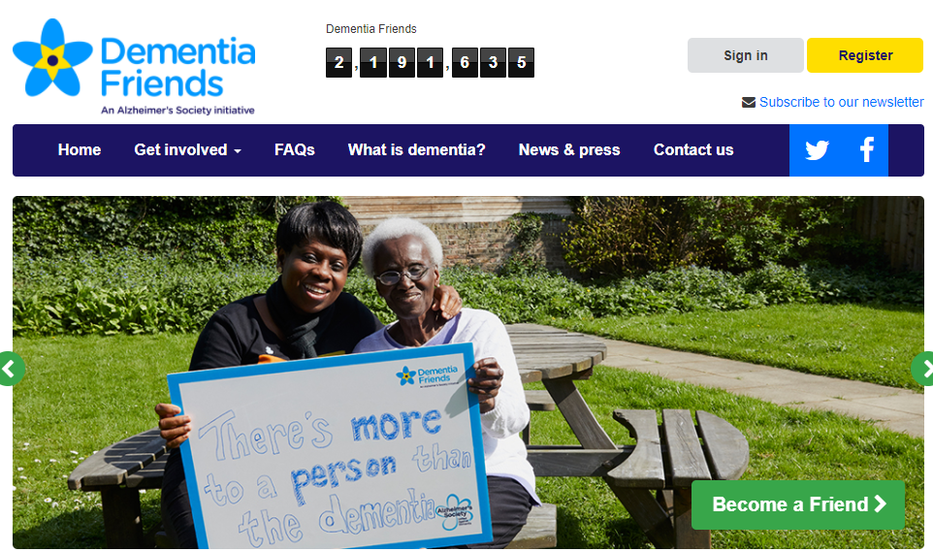
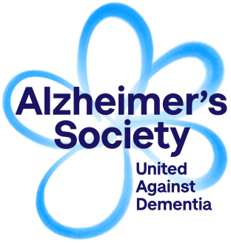
Notes:
We don’t set out to do this on our own. There are a lot of good resources out there. One key resource is provided by the Dementia Friends and Dementia Champions training offered through the Alzheimers’ society. One of the first steps a church can take towards being Dementia Friendly is encouraging their members to do the Dementia Friends training. It’s very straightforward and can even be done online. It’s particularly worth encouraging those who might welcome, and act as stewards and sidespeople to engage with this. Some people in the deanery might be able to train as Dementia Champions, and then they can offer the Dementia Friends training to local churches and other community groups.

Slide 3
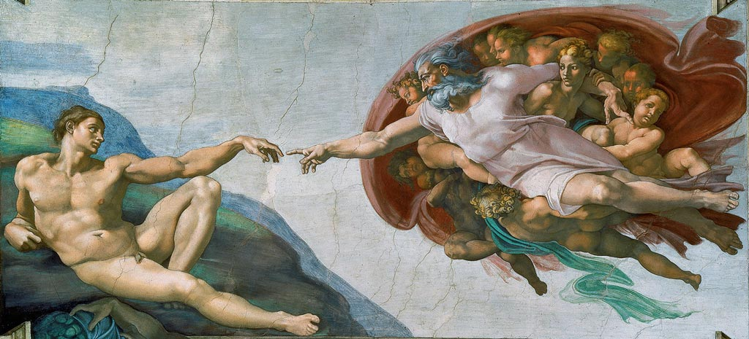
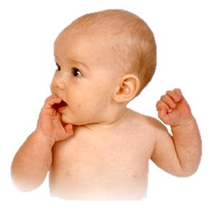
We are known, before we know
Notes:
Equally, we have our own Christian perspectives to bring to bear. Whether it is the biblical story of God’s making of humanity (Click - here illustrated by Michelangelo’s Sistine Chapel fresco of the creation of Adam),
(Click) or our normal human experience of being born, someone is there before us.
We need to forget the famous idea that who we are starts with some kind of individual thinking process – “I think, therefore I am” Instead we need the older wisdom reflected in Scripture “I am loved, therefore I am”, and “I am known, therefore I am”. When someone begins to forget who they are, they don’t lose value, they don’t cease to be persons. Our love holds them in their value and in their identity. Even more, as Christians, we believe that God’s love holds us and the whole world in being, gives everything and everyone the same priceless value. In the words of the psalmist: “For it was you who formed my inward parts; you knit me together in my mother's womb. I praise you, for I am fearfully and wonderfully made (Ps. 139:13-14 NRSV) There is a underlying life and identity which nothing and no-one can take away.

Slide 4
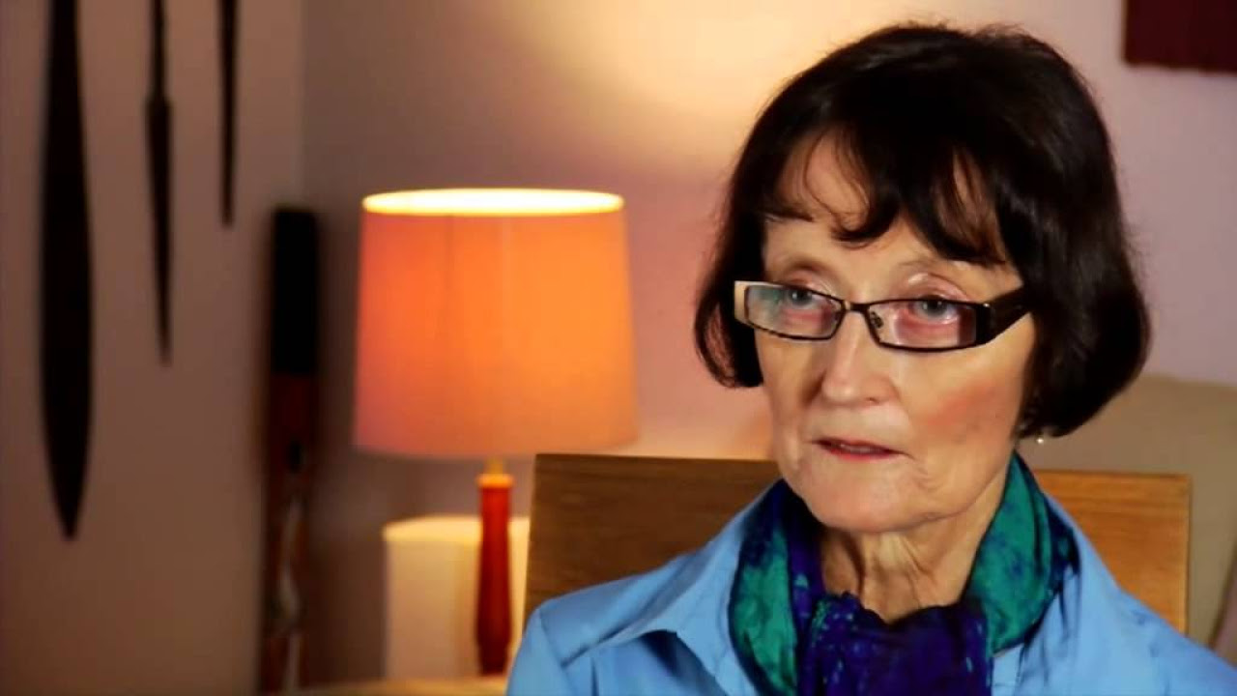
Listen to Christine Bryden talk about her experience of living with dementia
https://www.youtube.com/watch?v=7E49cK17qs0&t=1s
Notes:
Central to the idea of being dementia friendly is listening to and learning from those people who live with it. As you develop a strategy for your church, then the members of your congregation who themselves are living with dementia have valuable things to help you learn. Here’s an example: Australian author Christine Bryden tells a very powerful personal story. She has been a long term sufferer with dementia, and able to write and talk about her experience. Here is a link to her story on YouTube. Take a break from this presentation and watch it now.

Slide 5
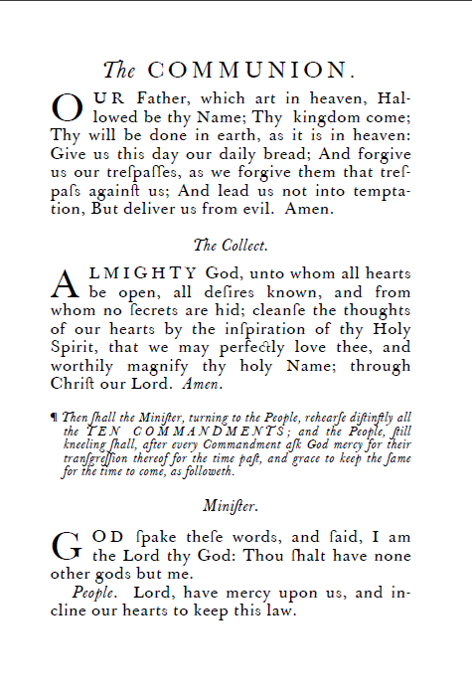
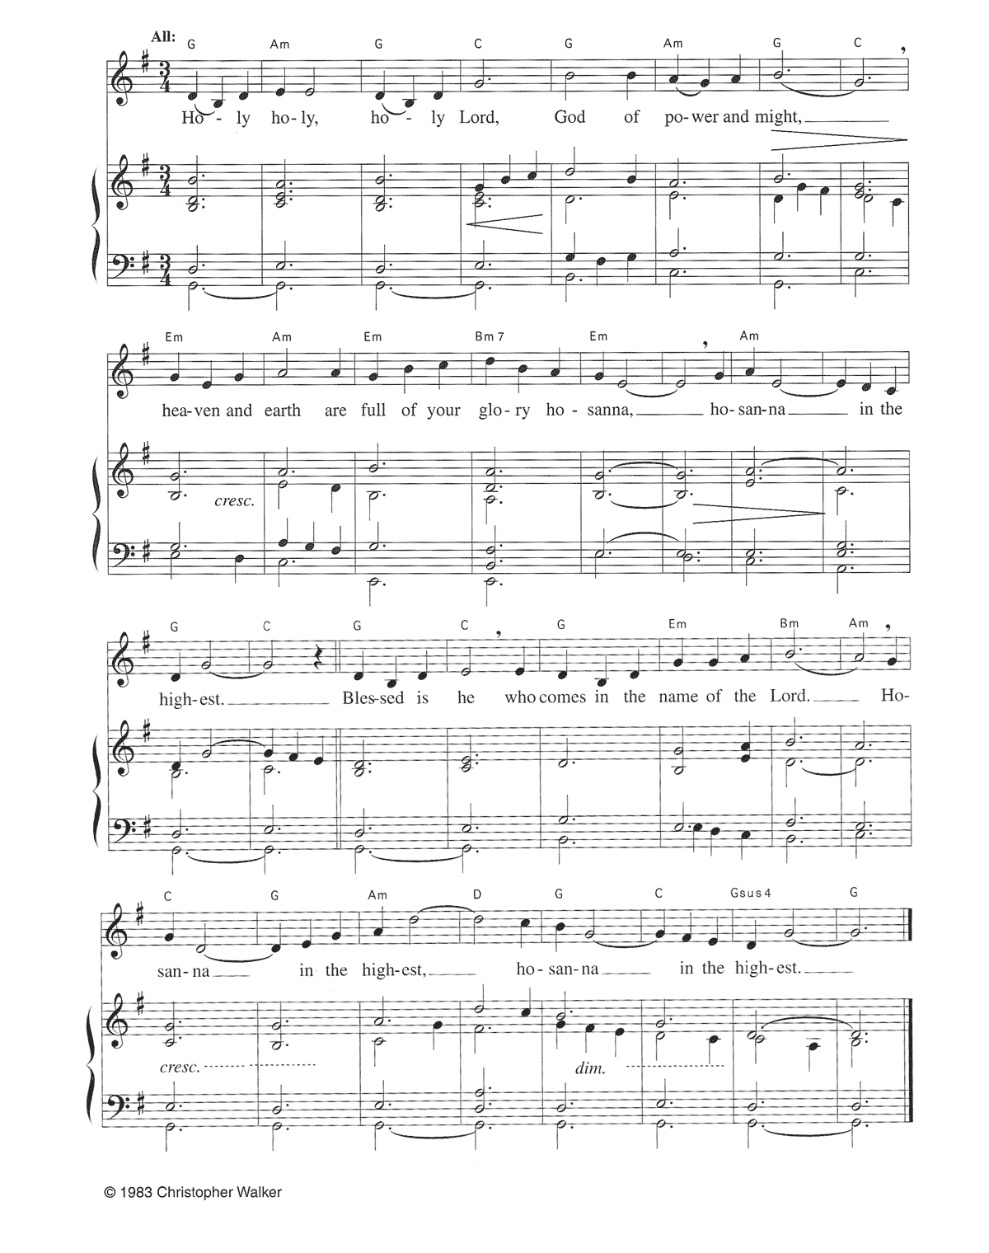
Notes:
Memories that get laid down very early in life stay a long time. Because of the wealth of emotions attached to them, long ago memorised prayers seem to stick in different bits of the brain to some other memories. Often that means that someone will still be able to join in the Lord’s Prayer who seems incapable of other forms of speech. If that’s true of words, it’s even more true of music.

Slide 6
Watch the story of Henry, and how music impacted his ability to remember
https://www.youtube.com/watch?v=fyZQf0p73QM
Notes:
There’s a remarkable demonstration of the power of music to bring people out of themselves, and bring memories alive in Alive Inside, a documentary about the Music and Memory project, also featuring Dr Oliver Sacks. The link to original video is here: https://www.youtube.com/watch?v=fyZQf0p73QM There are one or two shorter versions on YouTube to link to as well.

Slide 7
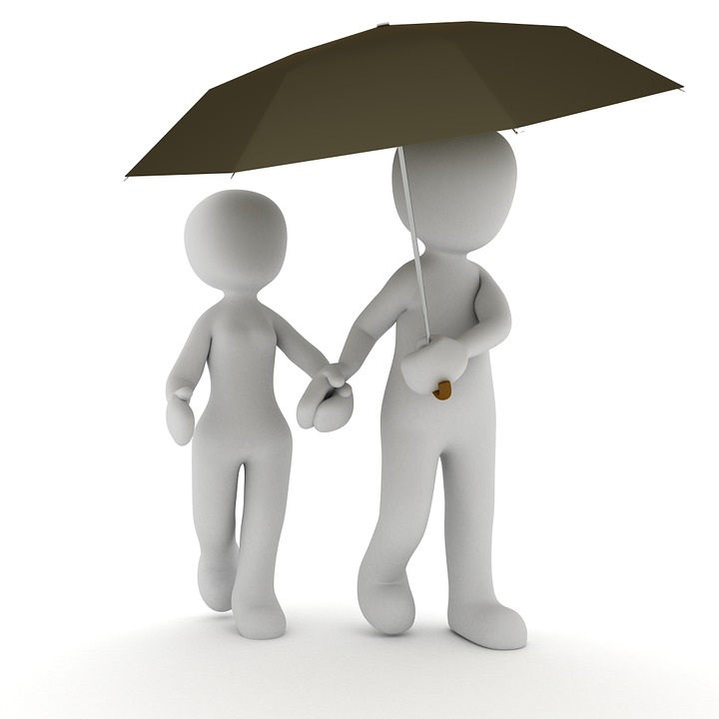
Notes:
It’s very important to remember that dementia is an umbrella term for a variety of different illnesses. There are different sorts of dementia, and people can be affected in varying ways, over different periods of time. We’re not just talking about one thing.

Slide 8
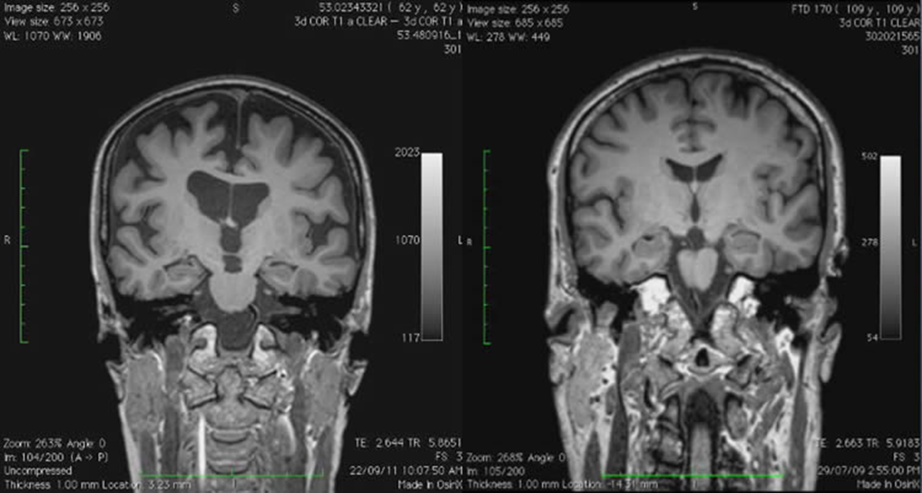
Christine Bryden’s MRI scan
16 years after dementia was diagnosed
Brain of person of similar age without dementia
Notes:
It’s equally important to remember that these varying types of dementia are physical illnesses. Nothing brought that home to me like this brain scan which Christine Bryden released to help people understand. Her brain scan is on the left, and you can see the damage compared to a person of similar age without dementia on the right. This is about physical changes, as much affecting the body as cancer or any other life-threatening illness.

Slide 9
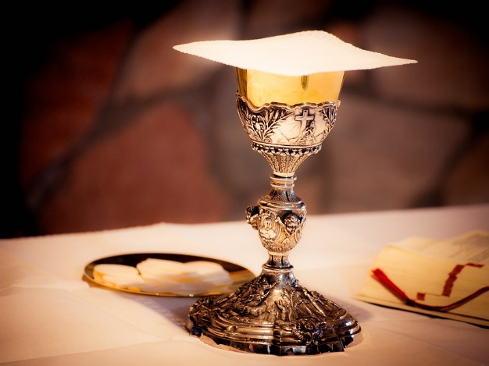
Notes:
Remembering is an important theme in the life of the church, we remember Jesus for successive generations, we remember Jesus for our world and those who don’t know God at the heart of our prayer. So when we pray for those who are forgetting, we are keeping them linked to that great commemoration of God and God’s love.

Slide 10
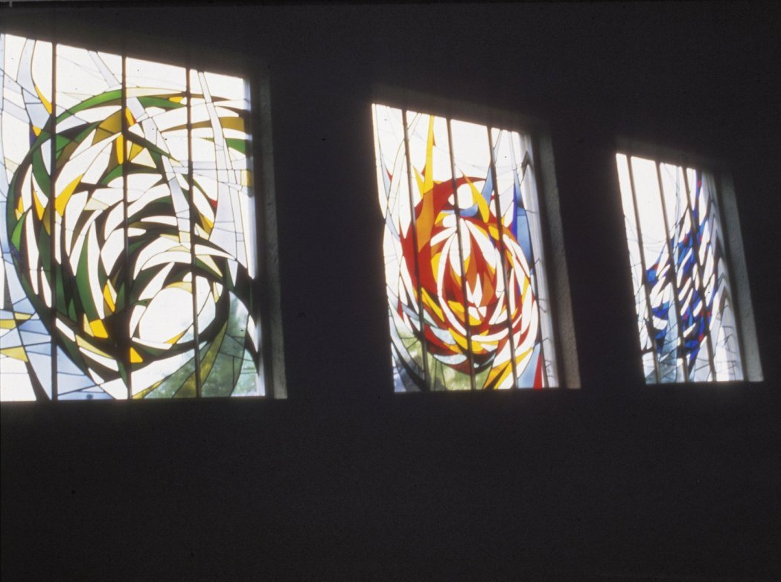
If I say, "Surely the darkness shall cover me, and the light around me become night,"
even the darkness is not dark to you;
the night is as bright as the day.
Ps. 139:11-12 NRSV
Notes:
But we know even more that we depend on God, not that God depends on us. So if our knowledge and memories of God are important, then God’s knowledge and memory of us is vital. God knows what we have forgotten. God holds our memories in his eternal mind. God holds our lives in his eternal love.
One way we can think of God when praying for people who live with dementia is that God is the guardian and keeper of their memories, and that to be raised from the dead is to be given back the story of who you are, the self you have forgotten.

Slide 11
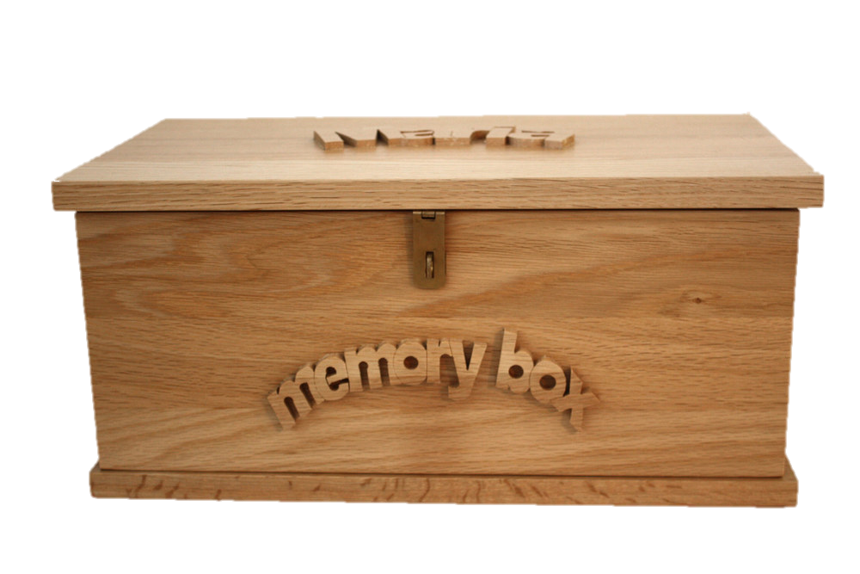
Notes:
But actual memories are important as well as a general theology of memory! One thing that can really help individuals is to keep their own “memory box” – a collection of precious items, photos and reminders that family, friends and carers can talk about with them, physical triggers for memories. Christine Bryden talks about how her husband could use words and images to construct a memory of what had happened that she could then walk into, and sometimes find her own memories. That’s the sort of thing that a memory box can help with: re-describing an aspect of the past in a way which might help it come alive and be remembered still. And if a memory box can help individuals, you might also want to think about a memory box or board for the church, photos of a past choir, or outing or fete. Bits of history that matter to people and help make the church what it is today.

Slide 12
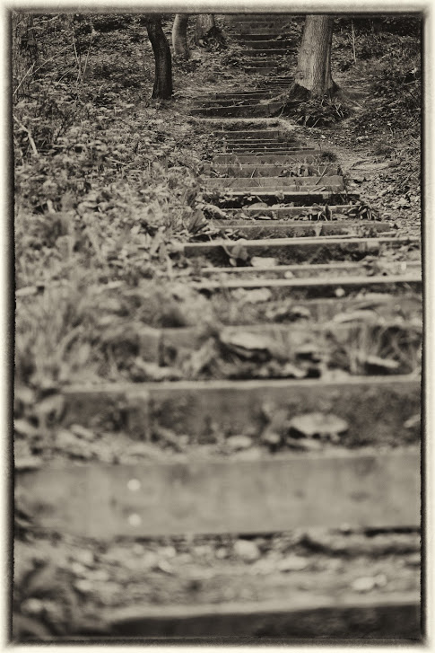
One step at a time
Notes:
I hope this presentation has given you some ideas about becoming more dementia friendly. There are ideas and resources on our diocesan web pages which we hope will help you make the next step of your journey on becoming a more dementia friendly church. We will be building on those over time, and sharing the good practice we discover around our diocese, so you can see how other parishes have done it. And if you have something good going on in your parish, get in touch with Doug Chaplin, Sam Setchell or James Atkinson in the diocesan office, and they will help share your good news story as well.

